Slide 1
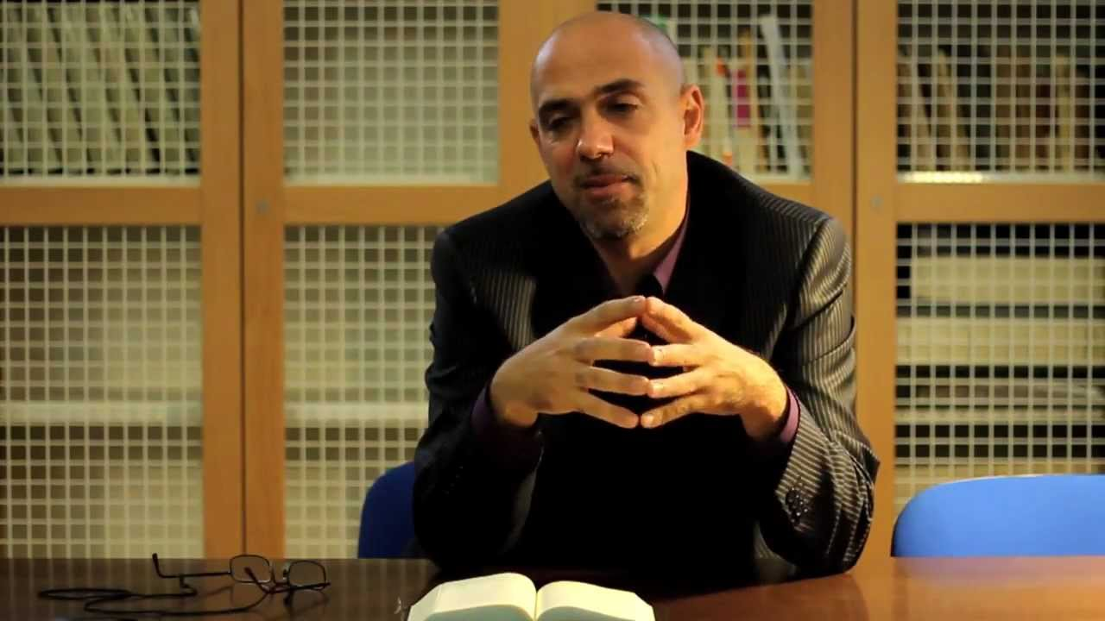
Week 15: Qohelet’s advice

Slide 2
First situation- Chapter 2
1-2 I will test myself with pleasure and enjoying good things; but this too was pointless. Of laughter I said “this is pointless”, and of pleasure “What’s the use of it?”
11 Then I looked at all that my hands had accomplished and at the work I had toiled at; and I saw that it was all meaningless and feeding on wind, and that there was nothing to be gained under the sun.
17 So I came to hate life I hated all the things for which I had worked because I saw that I would have to leave them to the man who will come after me
20 Thus I came to despair…
24-26 [man’s whole life is one of pain, and his work is full of stress; even at night his mind gets no rest.] This is incomprehensible.
(All quotations from the Complete Jewish Bible)

Slide 3
First wise saying
24: So there is nothing better for a man to do than eat, drink and let himself enjoy the good that results from his work.
I also realized that this is from God’s hand.

Slide 4
Second situation - Chapter 3
9-11 What does the worker gain from his efforts? I have seen the task God has given humanity to keep us occupied. He has made everything suited to its time; also, he has given human beings an awareness of eternity; but in such a way that they can’t fully comprehend, from beginning to end, the things God does.

Slide 5
Second wise saying - Chapter 3
12-13: [But] I know that there is nothing better for them to do than to be happy and enjoy themselves as long as they live. ¹³ Still, the fact that everyone can eat and drink and enjoy the good that results from all his work, is a gift of God.

Slide 6
Third situation - Chapter 5
9: The lover of money never has enough money …
13: Due to some misfortune ], the wealth turns to loss…
Just as he came from his mother’s womb, so he will go back naked as he came, and for his efforts he will take nothing that he can carry away in his hand. This too is a gross evil, that in every respect as he came, so will he go; thus what profit does he have after toiling to earn only vapour?
… This too is incomprehensible

Slide 7
Third wise saying - Chapter 5
17: This is what I have seen to be good:
that it is appropriate for a person to eat, drink and enjoy the good that results from all his work that he engages in under the sun for all the days of his life that God has given him, for this is his allotted portion.
Also, everyone to whom God has given riches and wealth, along with the power to enjoy it, so that he takes his allotted portion and finds pleasure in his work
— this is a gift of God.

Slide 8
Qoholet, Jesus and Paul
The parable of the rich barn-building farmer
Jesus and his disciples go to the wedding in Cana
Matthew’s feast
Jesus invites himself to Zaccheus’ table
Matt 11:18-19 For John came neither eating nor drinking, and they say, “He has a demon”; ¹⁹ the Son of Man came eating and drinking, and they say, “Look, a glutton and a drunkard, a friend of tax-collectors and sinners!” Yet wisdom is vindicated by her deeds.
1 Cor 10:31-33 So, whether you eat or drink, or whatever you do, do everything for the glory of God. ³² Give no offence to Jews or to Greeks or to the church of God, ³³ just as I try to please everyone in everything I do, not seeking my own advantage, but that of many, so that they may be saved.

Slide 9
Fourth situation - Chapter 6
1: I have seen another evil under the sun, and it weighs heavily on people: the case in which God gives someone riches, wealth and honour, so that he lacks nothing that he wants; but God does NOT give him the power to enjoy them, and some stranger gets to enjoy them — this is incomprehensible
11: There are many things that only add to futility, so how do humans benefit from them?¹² For who knows what is good for someone during life, during the days of his pointless life spent like a shadow? Who can tell what will happen under the sun when a person is gone?

Slide 10
Fourth wise (?) sayings Chapter 7
Oh dear. They CAN’T enjoy … Now what?
Qohelet’s somewhat circuitous advice follows in chapter 7 . . .
9: Don’t get angry quickly
13: Consider the work of God . . .
15: In my pointless life I’ve seen everything
16-17: So don’t be overly righteous or wise; why should you disappoint yourself? But don’t be overly wicked, and don’t be foolish; why should you die before your time?
18 Don’t grasp just one of these rules; take hold of the other as well; for he who is in fear of God will live by both of them.
[Oh dear, this isn’t getting Qohelet very far. He’s going to investigate further…]

Slide 11
Fifth situation - Chapter 7
25: So I turned myself and my thoughts to know, search out and seek wisdom and the reasons behind things, also to know how foolish it is to be wicked and stupid to act like a fool

Slide 12
Fifth wise saying
7:29: This is the only thing I have found, that God made human beings upright, but they have devised many schemes.
[Msg: . . . But we’re the ones who have made a mess of things]

Slide 13
Sixth situation - Chapter 8
. . . (Qohelet make various comments and concludes) . . .
9 on: All this have I seen as I applied my mind
The wicked get buried, the upright get forgotten
Punishment isn’t carried out
The Big Bad Sinner lives a long life
BUT
13: Things will not go well with the wicked
BUT Things happen to the righteous as if they were wicked
and things happen to the wicked as if they were good
Qohelet states that this is
INCOMPREHENSIBLE !!
OUTRAGEOUS !!!!

Slide 14
Sixth wise saying - Chapter 8
. . . but I’m going to keep calm and carry on . . .
15: So I recommend enjoyment — a person can do nothing better under the sun than eat, drink and enjoy himself; this is what should accompany him as he does his work for as long as God gives him to live under the sun.
16: It is impossible to grasp all the activity that is taking place under the sun . . . Even if a wise person thinks he knows it, he still won’t be able to grasp it.

Slide 15
Seventh situation - Chapter 9
9:1-3 I applied myself to all of this, sifted through it and concluded that the righteous and the wise, along with their deeds, are in God’s hands — a person cannot know whether these people and deeds will be rewarded with love or with hatred; all options are open. Anything can happen to anyone; the same thing can happen to the righteous as to the wicked, to the good and clean and to the unclean …
This is another evil among all those done under the sun, that the same events can occur to anyone.

Slide 16
Seventh wise saying
7: So go, eat your bread with joy, and drink your wine with a happy heart, for God has already accepted your deeds.
Let your clothing always be white, and never fail to perfume your head. Enjoy life with the wife you have loved throughout your incomprehensible life that he has given you under the sun . . .
for that is your allotted portion in life . . .

Slide 17
Summary of the seven situations / wise sayings
Everything is incomprehensible . . . So eat, drink and enjoy the good that results from [your] work. After all, it’s all from God’s hand
Everyone can eat and drink and enjoy the good that results from all their work, it is a gift of God.
. . . eat, drink and enjoy the good that results from all his work . . . along with the power to enjoy it, so that s/he takes her/his allotted portion and finds pleasure in his/her work — this is a gift of God.
Oh dear . . . Back to the drawing board
Humans are devious / they mess up
Eat, drink and enjoy yourself
Eat your bread with joy, and drink your wine with a happy heart, for God has already accepted your deeds . . .
Oh, and by the way, [according to Qohelet 9:10] we’re all going to end up in Sh’ol where there is neither working, nor planning, nor knowledge, nor wisdom.
But that’s for next week . . .

Slide 18
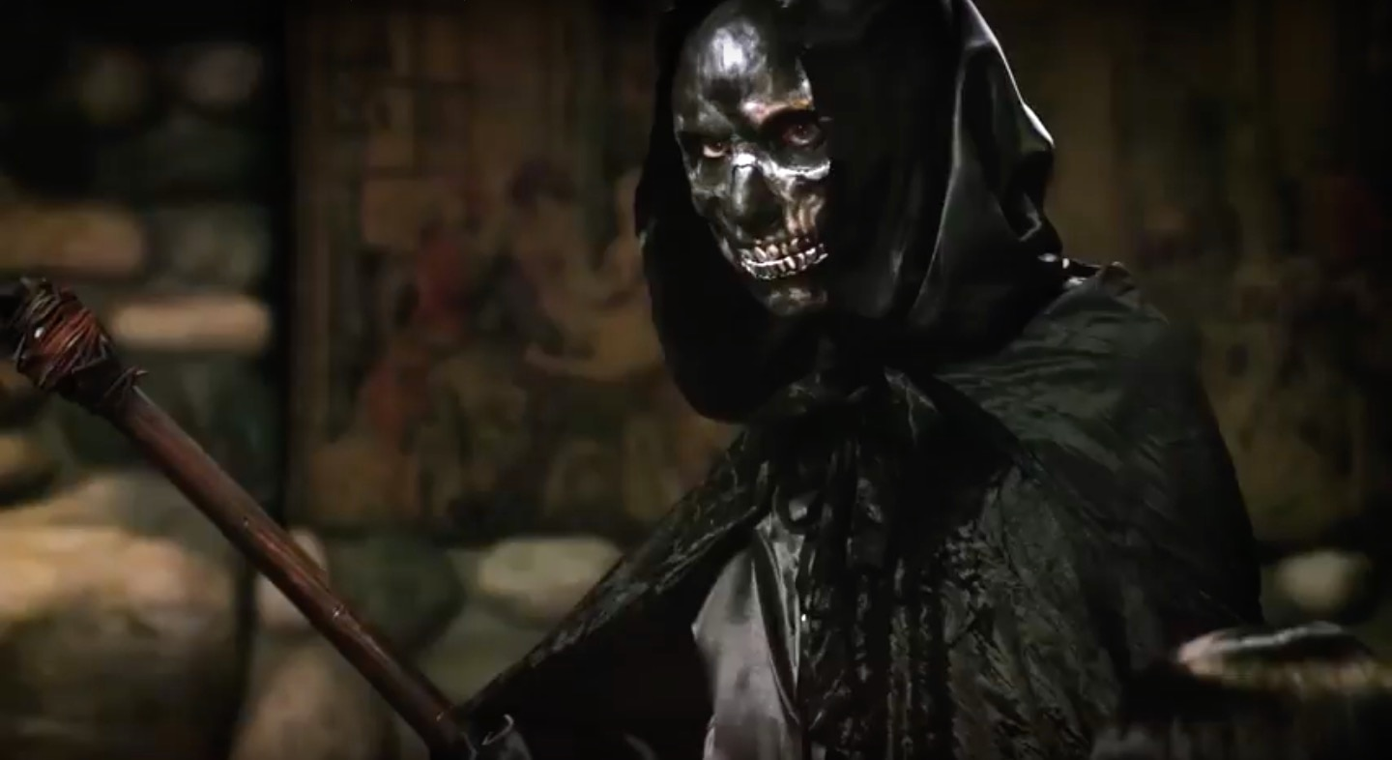
Next week: Sheol Qohelet, Gibson, Nouwen and Death

