Slide 1
The Book of Hebrews – January 29th 2022
The Second Warning
Route map for this morning
“Interesting stuff”
The Context of Warnings
Moses
Israelites test God
Israel at rest
Rest in Hebrew Bible (OT times)
Rest in Hebrews and elsewhere (C1 audience)
“Serious stuff”
2nd warning: Hebrews and 1 Corinthians (C1 and C21)

Slide 2
The Book of Hebrews – January 29th 2022
The Second Warning
Warnings
Don’t build houses on flood plains!
Build elsewhere or protect them!
Don’t route power cables too close to trees!
Put them underground!
Don’t forget to charge your phone before heading into the mountains!
Get yourself organised!

Slide 3
The Book of Hebrews – January 29th 2022
The Second Warning
First warning in Hebrews
2:1. Therefore
we must pay greater attention to what we have heard,
so that we do not drift away from it.

Slide 4
The Book of Hebrews – January 29th 2022
The Second Warning
Why Moses?
Called by God
(Human) leader out of Egypt
(Human) giver of the Law
Levite (Ex 2:1-4)
Priest (Ps 99:6)
Spoke face-to-face with God (Num 12:5-8)
“Faithful/entrusted in all My House” (Num 12:7
Inter-testamental period
Assumption of Moses (taken to heaven)
Sirach 45:2 - Moses was equal to the holy ones

Slide 5
The Book of Hebrews – January 29th 2022
The Second Warning
Testing and Resting in the Hebrew Bible
Ex 17 1-7
From the wilderness of Sin the whole congregation of the Israelites journeyed by stages, as the Lord commanded. They camped at Rephidim, but there was no water for the people to drink. The people quarreled with Moses, and said, ‘Give us water to drink.’ Moses said to them, ‘Why do you quarrel with me? Why do you test the Lord?’ But the people thirsted there for water; and the people complained against Moses and said, ‘Why did you bring us out of Egypt, to kill us and our children and livestock with thirst?’ So Moses cried out to the Lord, ‘What shall I do with this people? They are almost ready to stone me.’ The Lord said to Moses, ‘Go on ahead of the people, and take some of the elders of Israel with you; take in your hand the staff with which you struck the Nile, and go. I will be standing there in front of you on the rock at Horeb. Strike the rock, and water will come out of it, so that the people may drink.’

Slide 6
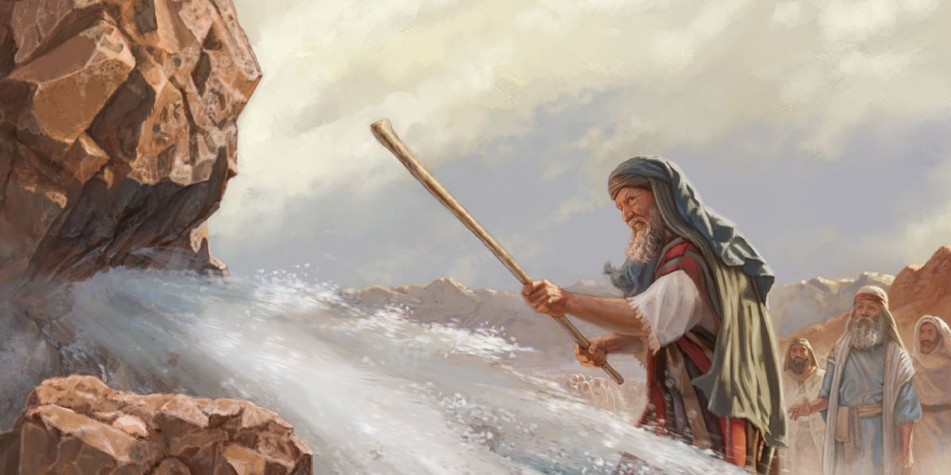
The Book of Hebrews – January 29th 2022
The Second Warning
Moses did so, in the sight of the elders of Israel. ⁷ He called the place Massah and Meribah, because the Israelites quarreled and tested the Lord, saying, ‘Is the Lord among us or not?’

Slide 7
The Book of Hebrews – January 29th 2022
The Second Warning
Testing and Resting in the Hebrew Bible
Deut 6:13-19. The Lord your God you shall fear; him you shall serve, and by his name alone you shall swear. Do not follow other gods, any of the gods of the peoples who are all around you, because the Lord your God, who is present with you, is a jealous God. The anger of the Lord your God would be kindled against you and he would destroy you from the face of the earth. Do not put the Lord your God to the test, as you tested him at Massah. You must diligently keep the commandments of the Lord your God, and his decrees, and his statutes that he has commanded you. Do what is right and good in the sight of the Lord, so that it may go well with you, and so that you may go in and occupy the good land that the Lord swore to your ancestors to give you, thrusting out all your enemies from before you, as the Lord has promised….
.
6:25. If we diligently observe this entire commandment before the Lord our God, as he has commanded us, we will be in the right.’

Slide 8
The Book of Hebrews – January 29th 2022
The Second Warning
Testing and Resting in the Hebrew Bible
Ezekiel 20:13-17. Then I thought I would pour out my wrath upon them in the wilderness, to make an end of them. But I acted for the sake of my name, so that it should not be profaned in the sight of the nations, in whose sight I had brought them out. Moreover, I swore to them in the wilderness that I would not bring them into the land that I had given them, a land flowing with milk and honey, the most glorious of all lands, because they rejected my ordinances and did not observe my statutes, and profaned my sabbaths; for their heart went after their idols. Nevertheless, my eye spared them, and I did not destroy them or make an end of them in the wilderness.

Slide 9
The Book of Hebrews – January 29th 2022
The Second Warning
Testing and Resting in the Hebrew Bible
Ps 95:7b-11. O that today you would listen to his voice! Do not harden your hearts, as at Meribah, as on the day at Massah in the wilderness, when your ancestors tested me, and put me to the proof, though they had seen my work. For forty years I loathed that generation and said, ‘They are a people whose hearts go astray, and they do not regard my ways.’ Therefore in my anger I swore, ‘They shall not enter my rest.’

Slide 10
The Book of Hebrews – January 29th 2022
The Second Warning
Ps 95 / Hebrews 3
Ps 95:7b-11. O that today you would listen to his voice! Do not harden your hearts, as at Meribah, as on the day at Massah in the wilderness, when your ancestors tested me, and put me to the proof, though they had seen my work. For forty years I loathed that generation and said, ‘They are a people whose hearts go astray, and they do not regard my ways.’ Therefore in my anger I swore, ‘They shall not enter my rest.’
Hb 3: 7-11. ‘Today, if you hear his voice, do not harden your hearts as in the rebellion, as on the day of testing in the wilderness, where your ancestors put me to the test, though they had seen my works for forty years. Therefore I was angry with that generation, and I said, “They always go astray in their hearts, and they have not known my ways.” As in my anger I swore, “They will not enter my rest.”’

Slide 11
The Book of Hebrews – January 29th 2022
The Second Warning
Rest for the Israelites
Joshua 11:23. Joshua took the whole land, according to all that the Lord had spoken to Moses; and Joshua gave it for an inheritance to Israel according to their tribal allotments. And the land had rest from war.
Joshua 21:44. And the Lord gave them rest on every side just as he had sworn to their ancestors; not one of all their enemies had withstood them, for the Lord had given all their enemies into their hands.
Judges 5:31. And the land had rest for forty years.

Slide 12
The Book of Hebrews – January 29th 2022
The Second Warning
Rest according to David, Solomon, Jesus and Hebrews
1 Chron 23:25. For David said, ‘The Lord, the God of Israel, has given rest to his people; and he resides in Jerusalem for ever. (David’s ‘final’ speech.)
Proverbs 19:23. The fear of the Lord is life indeed; filled with it one rests secure and suffers no harm
Psalm 37. A Psalm of trust. (Go read it!)
Matthew 11:28. Come to me, all you that are weary and are carrying heavy burdens, and I will give you rest
Hebrews 4:9. So then, a sabbath rest still remains for the people of God;

Slide 13
The Book of Hebrews – January 29th 2022
The Second Warning
Rest
Stopping
Cessation of work or activity
Place where one rests and lives
Rest for the Israelite in the land of Canaan
Rest for the Israelites in Jerusalem.
Levites (1 Chr 23:25 ref David) – no more moving the tabernacle around
Is 66:1 Thus says the Lord: Heaven is my throne and the earth is my footstool; what is the house that you would build for me, and what is my resting-place?

Slide 14
The Book of Hebrews – January 29th 2022
The Second Warning
Rest
Gnostic ideas of “rest” likely to have come from Hebrews’ thought
Middle Platonism (~90bce – C3): Rest as the highest realm of being in contrast to the constantly changing material world
Philo: Rest belongs in the fullest sense to God and to him alone
often identifies God’s rest with Sabbath – both being symbols of transcendence
Apocalyptic texts: Rest identified with a restored paradise
Rabbinic texts: interpret Ps 95 as the coming aeon and Sabbath as the foreshadowing of the coming kingdom
Heb 4:9. Rest as Sabbath observance: “In Jewish tradition generally the sabbath was not simply a time of quiet inactivity but festive praise and celebration.” (Source: Hebrews, Attridge, Hermaneia series)

Slide 15
The Book of Hebrews – January 29th 2022
The Second Warning
Rest
Thompson: “The author’s* appeal to enter the transcendent rest would have been intelligible to a wide audience in the first century. This rest is the author’s equivalent to his numerous images for the heavenly world. It is the “city with foundations whose maker and builder is God, homeland and heavenly Jerusalem.”
(the writer of Hebrews)
Source: Hebrews, J.W. Thompson, Paideia Commentaries on the New Testament, Baker Academic, 2008.

Slide 16
The Book of Hebrews – January 29th 2022
The Second Warning
2nd warning
3:7-19 and 4:1-13
Don’t - harden your hearts
Don’t - rebel against God
Don’t - test God
Don’t -go astray
DO - Exhort one another every day
DO – Cease from labours
DO - Make every effort

Slide 17
The Book of Hebrews – January 29th 2022
The Second Warning
2nd warning: Hebrews 3 -4
3:12-13. Take care, brothers and sisters, that none of you may have an evil, unbelieving heart that turns away from the living God. But exhort one another every day, as long as it is called ‘today’, so that none of you may be hardened by the deceitfulness of sin.
4:1. while the promise of entering his rest is still open, let us take care that none of you should seem to have failed to reach it.
4:8-11. For if Joshua had given them rest, God would not speak later about another day. So then, a Sabbath rest still remains for the people of God; for those who enter God’s rest also cease from their labours as God did from his. Therefore let us make every effort to enter that rest, so that no one may fall through such disobedience as theirs.

Slide 18
The Book of Hebrews – January 29th 2022
The Second Warning
2nd warning: 1 Corinthians 10
1 Cor 10: 1-13. “Warnings from Israel’s History”.
I do not want you to be unaware, brothers and sisters, that our ancestors were all under the cloud, and all passed through the sea, and all were baptized into Moses in the cloud and in the sea, and all ate the same spiritual food, and all drank the same spiritual drink. For they drank from the spiritual rock that followed them, and the rock was Christ. Nevertheless, God was not pleased with most of them, and they were struck down in the wilderness.
Now these things occurred as examples for us, so that we might not desire evil as they did. Do not become idolaters as some of them did; as it is written, ‘The people sat down to eat and drink, and they rose up to play.’ We must not indulge in sexual immorality as some of them did, and twenty-three thousand fell in a single day. We must not put Christ to the test, as some of them did, and were destroyed by serpents. And do not complain as some of them did, and were destroyed by the destroyer. These things happened to them to serve as an example, and they were written down to instruct us, on whom the ends of the ages have come. So if you think you are standing, watch out that you do not fall. No testing has overtaken you that is not common to everyone. God is faithful, and he will not let you be tested beyond your strength, but with the testing he will also provide the way out so that you may be able to endure it.

Slide 19
REST – thoughts from our participants
Trust (x lots of comments!)
Relief from suffering
Constancy of God
Rest from “thoughts”! (aka worry?)
Nouwen quote – “inner safety”

