Slide 1
Virtual Vestry #18 Doing WHAT on the Sabbath!!??

Slide 2
Read the texts

Slide 3
The Sabbath ~ why?
God commanded it.
It is good to spend time with God.
It’s for our benefit.
Creation/identity

Slide 4
1. God commanded it
Exodus 20: Remember the sabbath day, and keep it holy. For six days you shall labour and do all your work. But the seventh day is a sabbath to the Lord your God; you shall not do any work—you, your son or your daughter, your male or female slave, your livestock, or the alien resident in your towns. For in six days the Lord made heaven and earth, the sea, and all that is in them, but rested the seventh day; therefore the Lord blessed the sabbath day and consecrated it.

Slide 5
1. God commanded it
If God commanded it does anything else matter? Do we need further reasons?
If God commanded it then what should my response be? Maybe, ask the question “how should I ‘rest’”?
Jewish ideas on ‘how’
Adventist ideas on ‘how’

Slide 6
Jewish ideas on ‘how’
Jewish law (halakha) prohibits doing any form of melakhah (מְלָאכָה, plural melakhoth) on Shabbat, unless an urgent human or medical need is life-threatening. Though melakhah is commonly translated as "work" in English, a better definition is "deliberate activity" or "skill and craftmanship". There are 39 categories of melakhah:

Slide 7
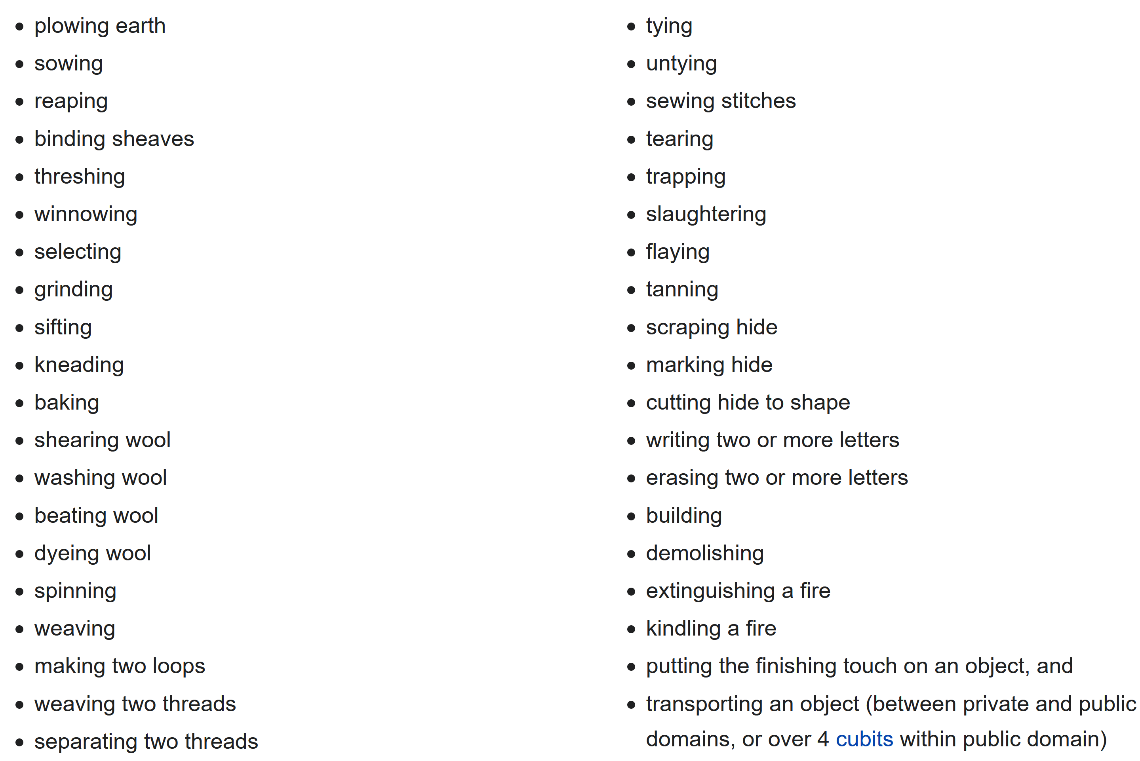

Slide 8
1. God commanded it
If God commanded it does anything else matter? Do we need further reasons?
If God commanded it then what should my response be? Maybe, ask the question “how should I ‘rest’”?
Jewish ideas on ‘how’
Adventist ideas on ‘how’
Adventist idea that Sabbath is a defining feature of God’s remnant church. It’s that important.

