Slide 1
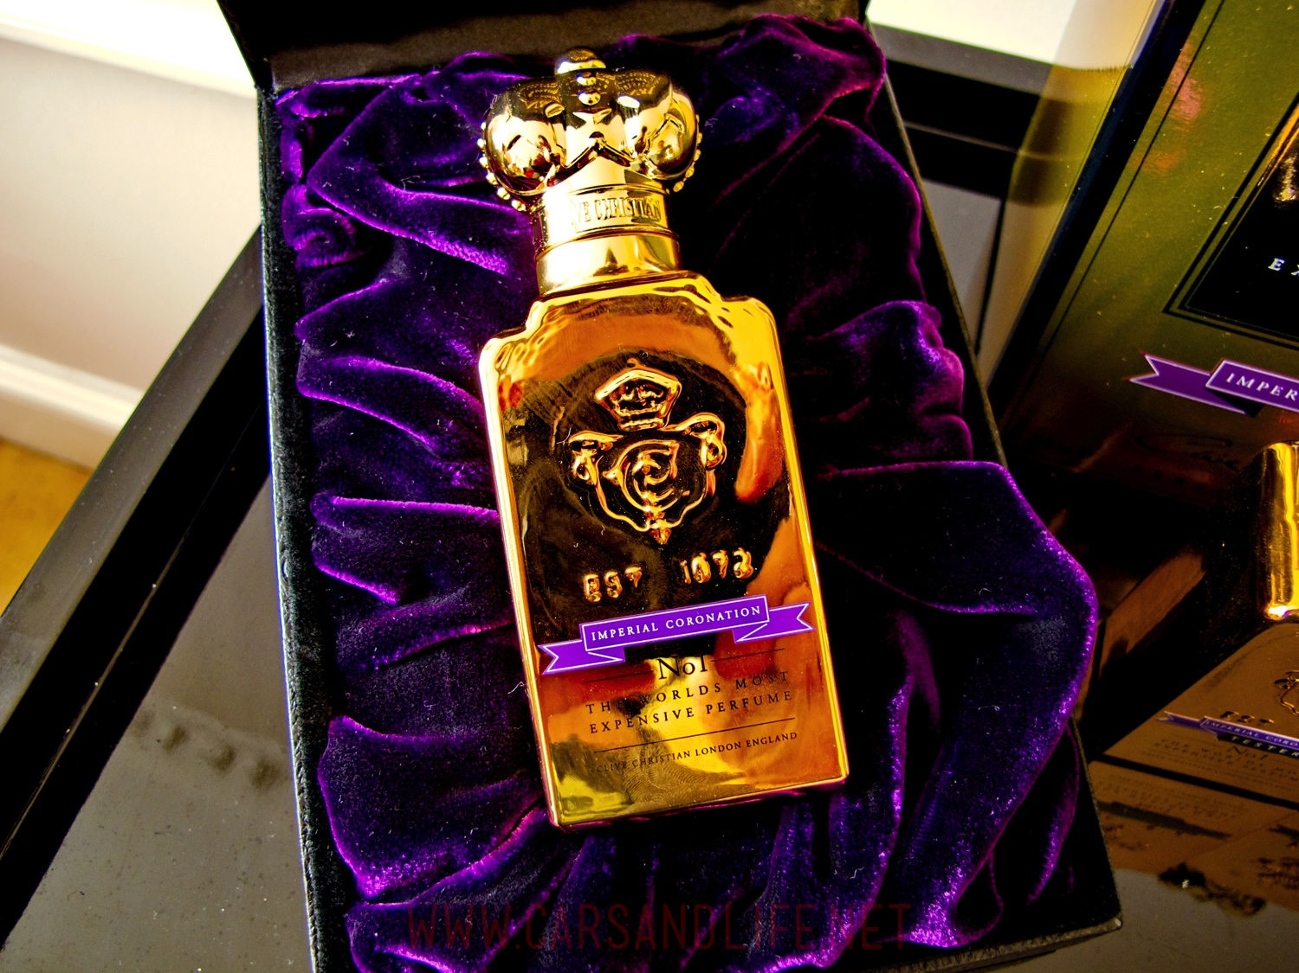
The Life of Christ - Week 30 - October 9th
Where’s that smell coming from?

Slide 2
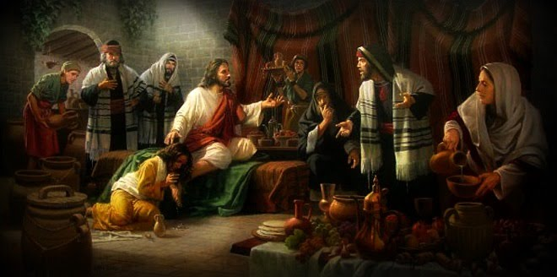
The Life of Christ - Week 30 - October 9th
Where’s that smell coming from?

Slide 3
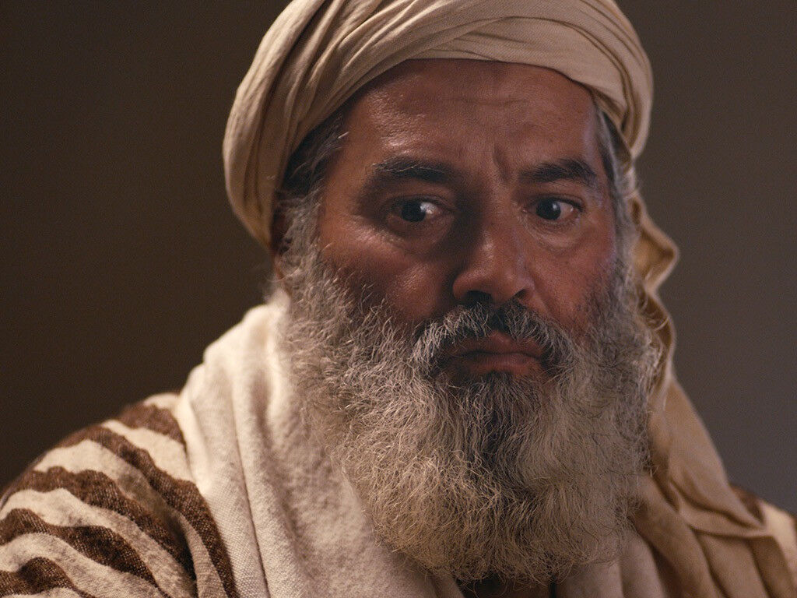
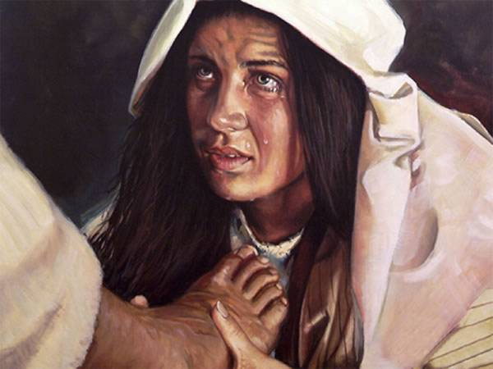
The Life of Christ - Week 30 - October 9th
Where’s that smell coming from?

Slide 4
The Life of Christ - Week 30 - October 9th
Where’s that smell coming from?
Stage 1: Dramatic action – there’s perfume in the air
Stage 2: Jesus tells a story
Stage 3: Jesus points fingers – turns out there are two smells for the price of one

Slide 5
The Life of Christ - Week 30 - October 9th
Location of the event
Matthew: Bethany House of Simon the leper
Mark: Bethany House of Simon the leper
Luke: Not stated House of Simon, a Pharisee
John: Bethany Home of Lazarus

Slide 6
The Life of Christ - Week 30 - October 9th
When does it take place?
Matthew: A few days before Jesus is crucified
Mark: Two days before Passover
Luke: Between John’s imprisonment and death *
John: Six days before Passover

Slide 7
The Life of Christ - Week 30 - October 9th
Where is the ointment poured?
Matthew: On Jesus’ head
Mark: On Jesus’ head
Luke: On Jesus’ feet
John: On Jesus’ feet

Slide 8
The Life of Christ - Week 30 - October 9th
What’s the complaint?
Matthew: This is waste – money should go to poor
Mark: This is waste – money should go to poor
Luke: She’s a sinner and Jesus lets her touch him (thought)*
John: This is waste – money should go to poor

Slide 9
The Life of Christ - Week 30 - October 9th
How does Jesus respond to the complaint?
Matthew: Leave her alone, she has served me,
the poor always with you, seen as preparation for burial, she will be remembered
Mark: (as Matthew)
Luke: Jesus talks to Simon about service and forgiveness, Jesus forgives the woman and commends her faith *
John: (similar to Matthew)

Slide 10
The Life of Christ - Week 30 - October 9th
Chiasm in Luke 7: 44-47
Woman brings perfume
Stands at Jesus’ feet
Bathes Jesus feet with tears and kisses
Uses her hair to dry them
Anoints Jesus’ feet with kisses and ointment
Kneels at Jesus’ feet
Woman takes away forgiveness and peace

Slide 11
The Life of Christ - Week 30 - October 9th

Slide 12
The Life of Christ - Week 30 - October 9th
Parallelism in Luke 7: 37-39
You gave me no water for my feet
She bathed my feet with her tears
You gave me no kiss
She has not stopped kissing my feet
You did not anoint my head with oil
She anointed my feet with ointment
(silence)
Her sins have been forgiven
(silence)
Her faith has saved her and she goes in peace

